Slide 1
Camera Automation
Sertan Kaya

Slide 2
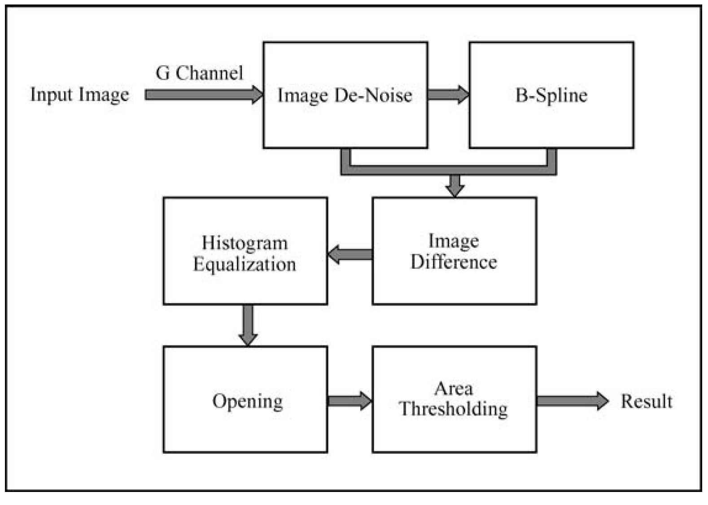
Dirt Detection (Based on Article): Flowchart

Slide 3

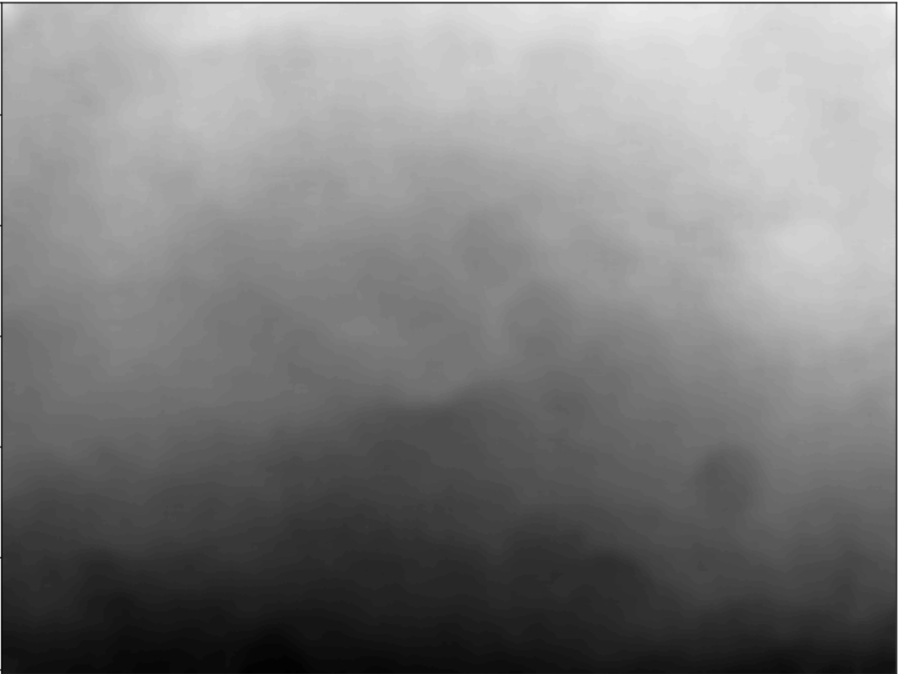
Dirt Detection (Based on Article): Denoising
Green channel Image[:,:,1]
Image Denoising by
Median Filter by 99x99

Slide 4
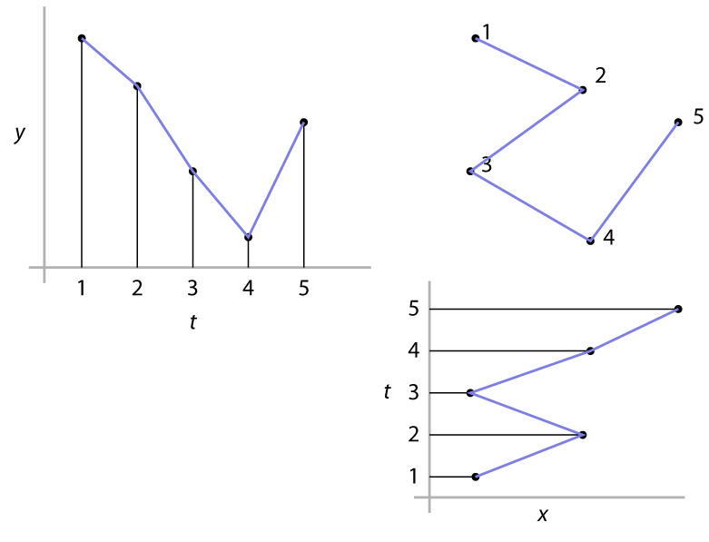
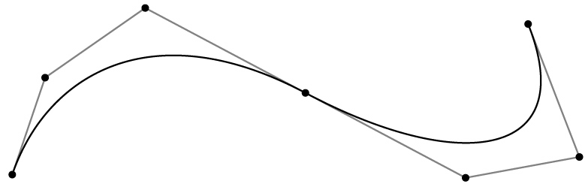
B-Spline Curves
In many applications, we need smooth shapes. That is, without discontinuities
Generally spline curves is a piecewise polynomial
Specified by a sequence of control points
Shape is guided by control points (aka control polygon)
interpolating: passes through points
approximating: merely guided by points

Slide 5

Dirt Detection (Based on Article): Control points
Control points
Image Denosing by
Median Filter by 99x99
Image size: (3024, 4032)
Common denominator: 84
So, (36,48) control points

Slide 6

Dirt Detection (Based on Article): using B-Spline to generate vertical lines
Control points
Image size: (3024, 4032)
Common denominator: 84
So, (36,48) control points
Vertical lines by 84 pixels apart

Slide 7
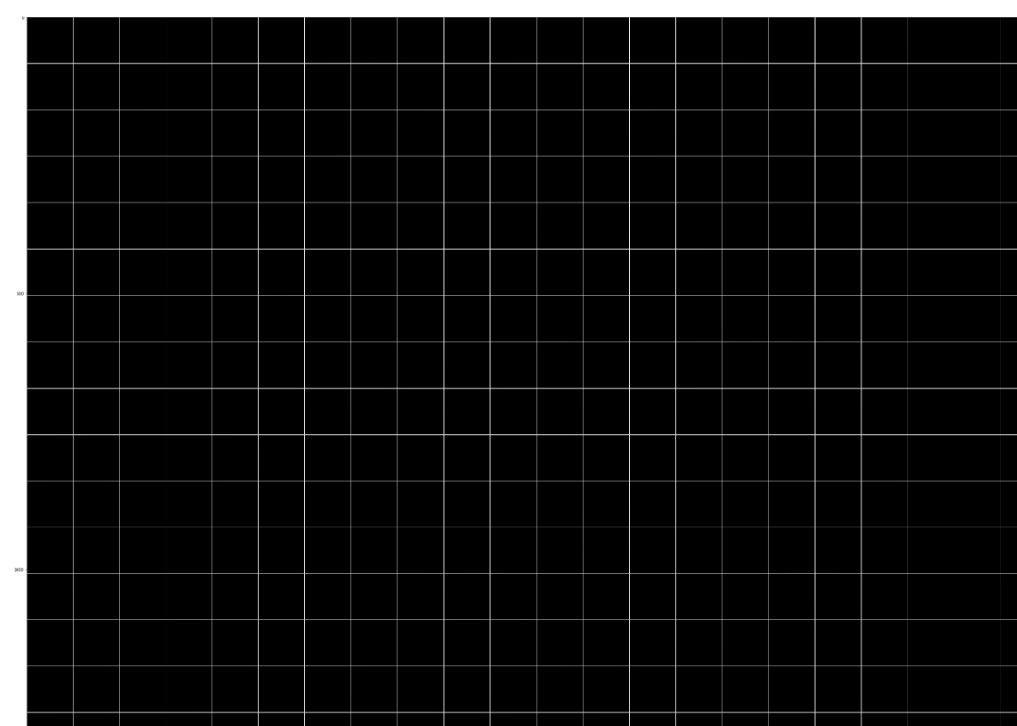
Dirt Detection (Based on Article): using B-Spline to generate vertical and horizontal lines
Vertical lines by 84 pixels apart
Vertical and horizontal lines by 84 pixels apart

Slide 8
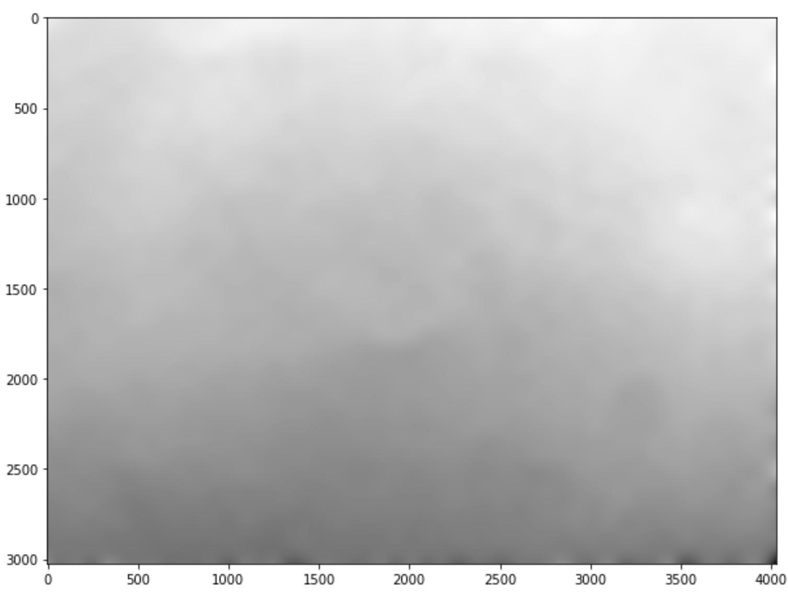
Dirt Detection (Based on Article): using B-Spline to generate background image
Vertical and horizontal lines by 84 pixels apart
Background image

Slide 9
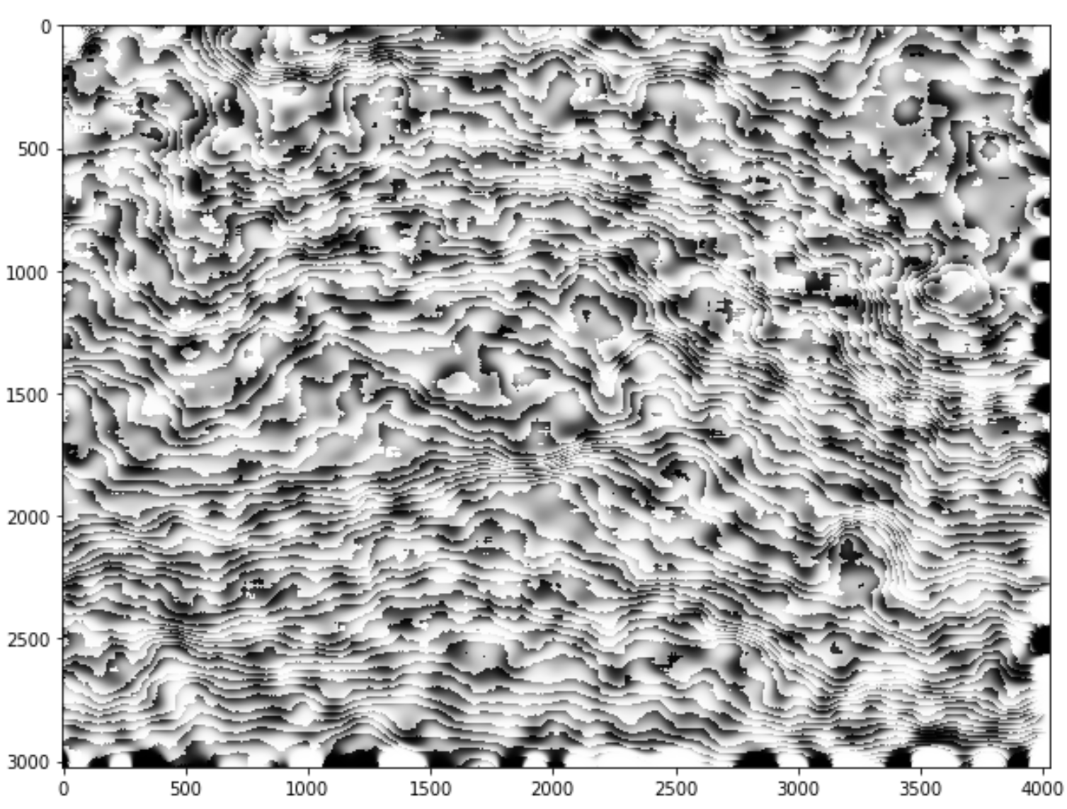
Dirt Detection (Based on Article): Histogram equalization
Background image
Histogram equalized image

Slide 10
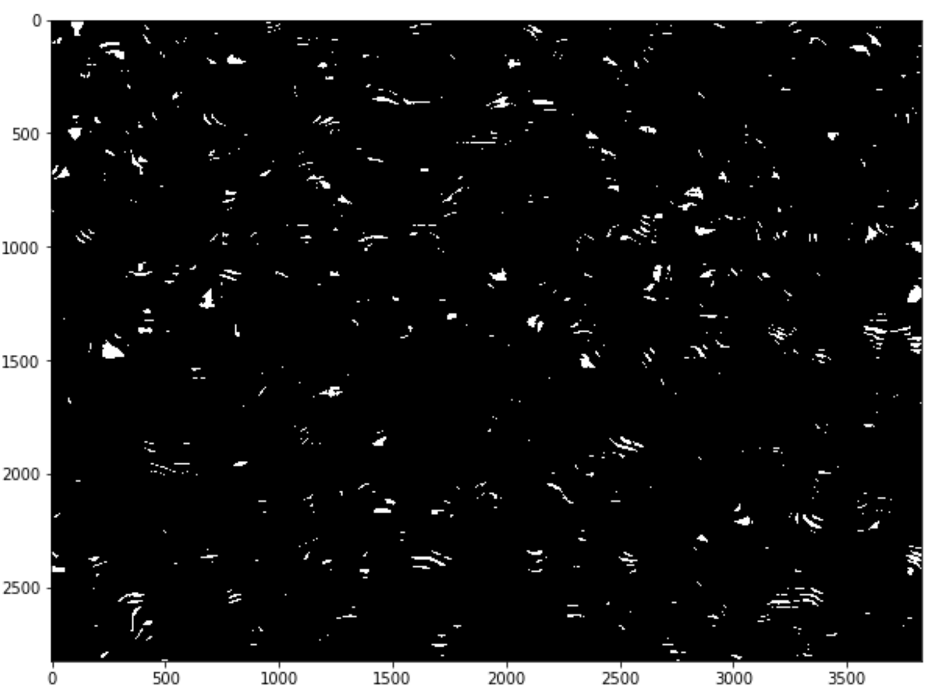
Dirt Detection (Based on Article): Thresholding and setting a threshold
Histogram equalized image
Thresholded image under a certain threshold

Slide 11
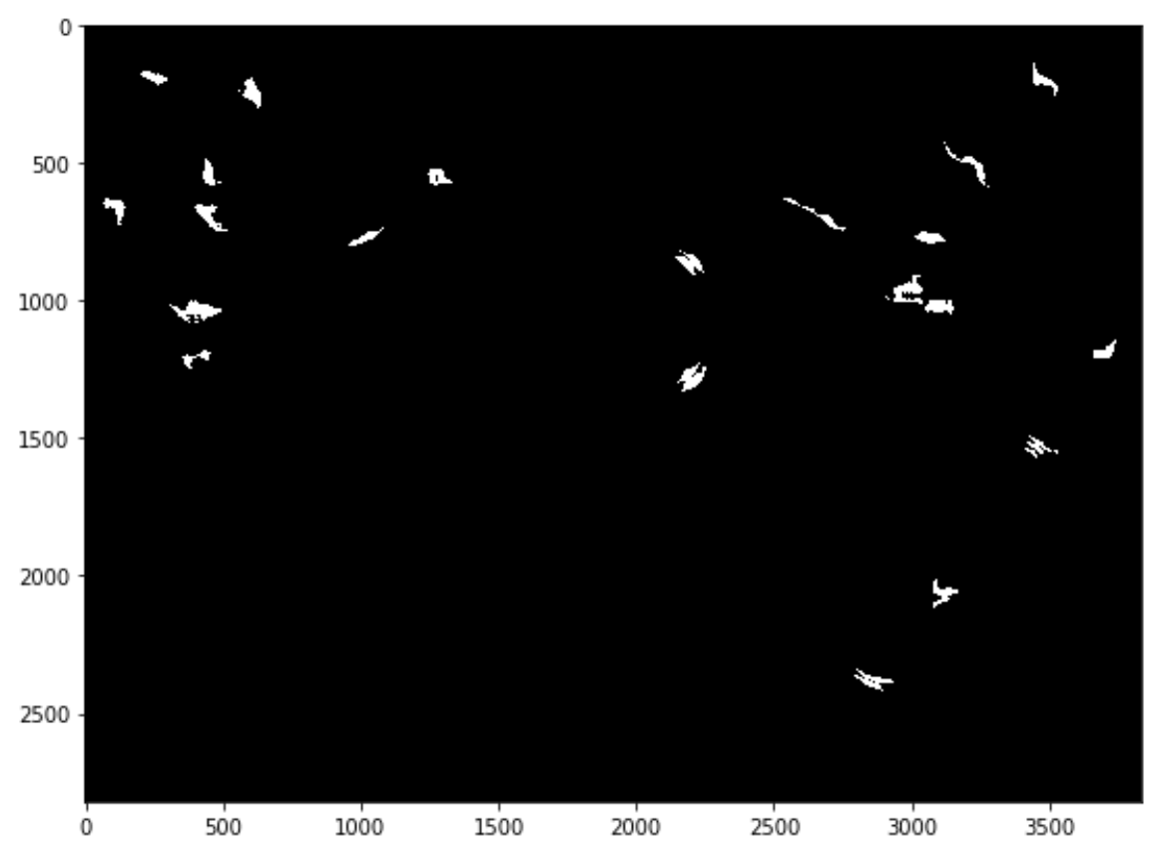
Dirt Detection (Based on Article): Morphological operations
Thresholded image under a certain threshold
Labelling and Removing small objects

Slide 12
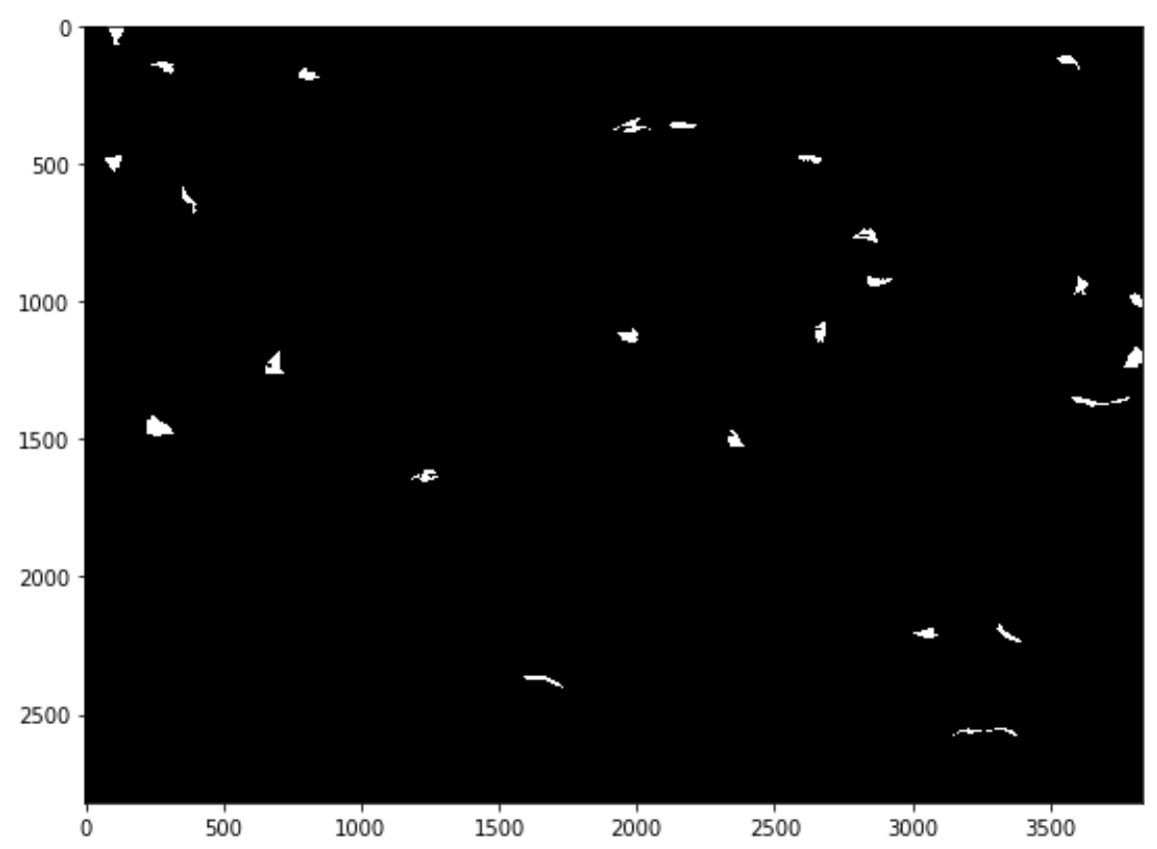
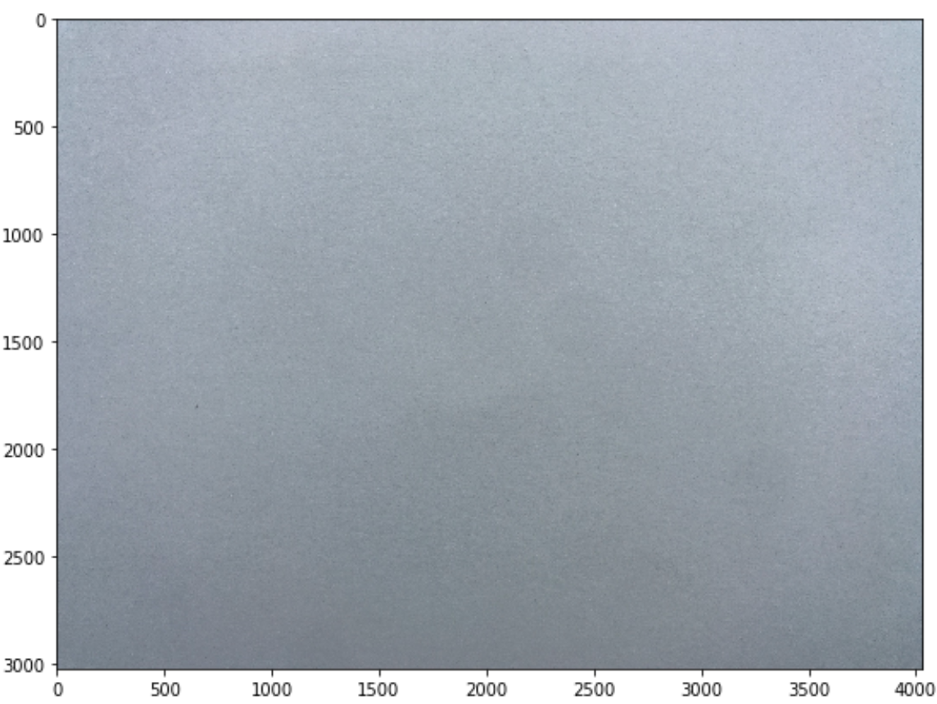
Dirt Detection (Based on Article): Marking detected regions
Labelling and Removing small objects

Slide 13
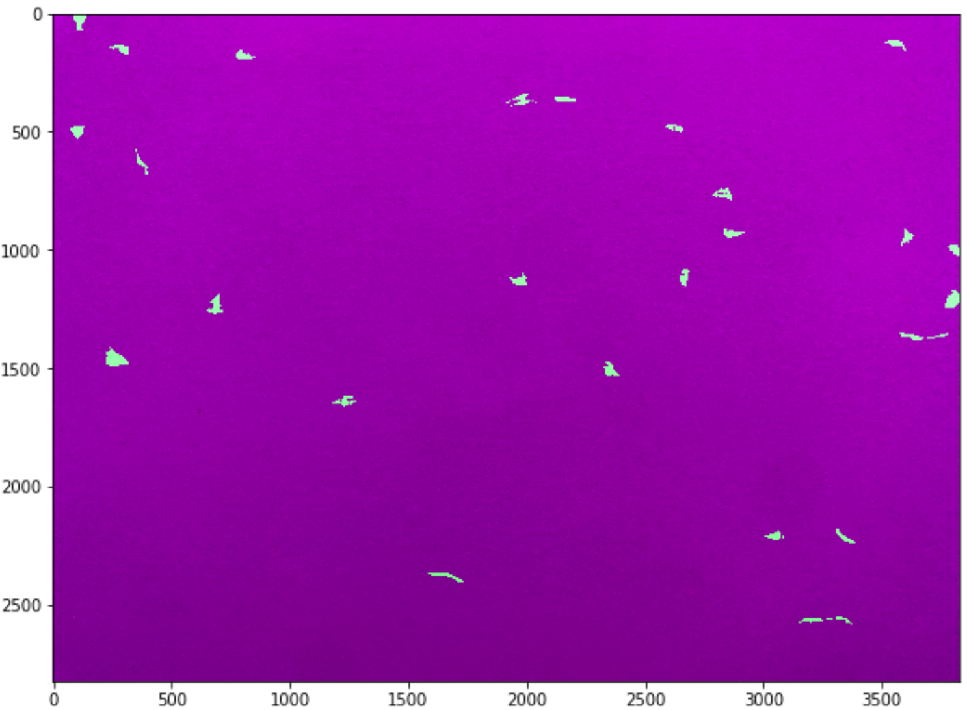
Dirt Detection (Based on Article): Original with Detected markers
Original image

Slide 14
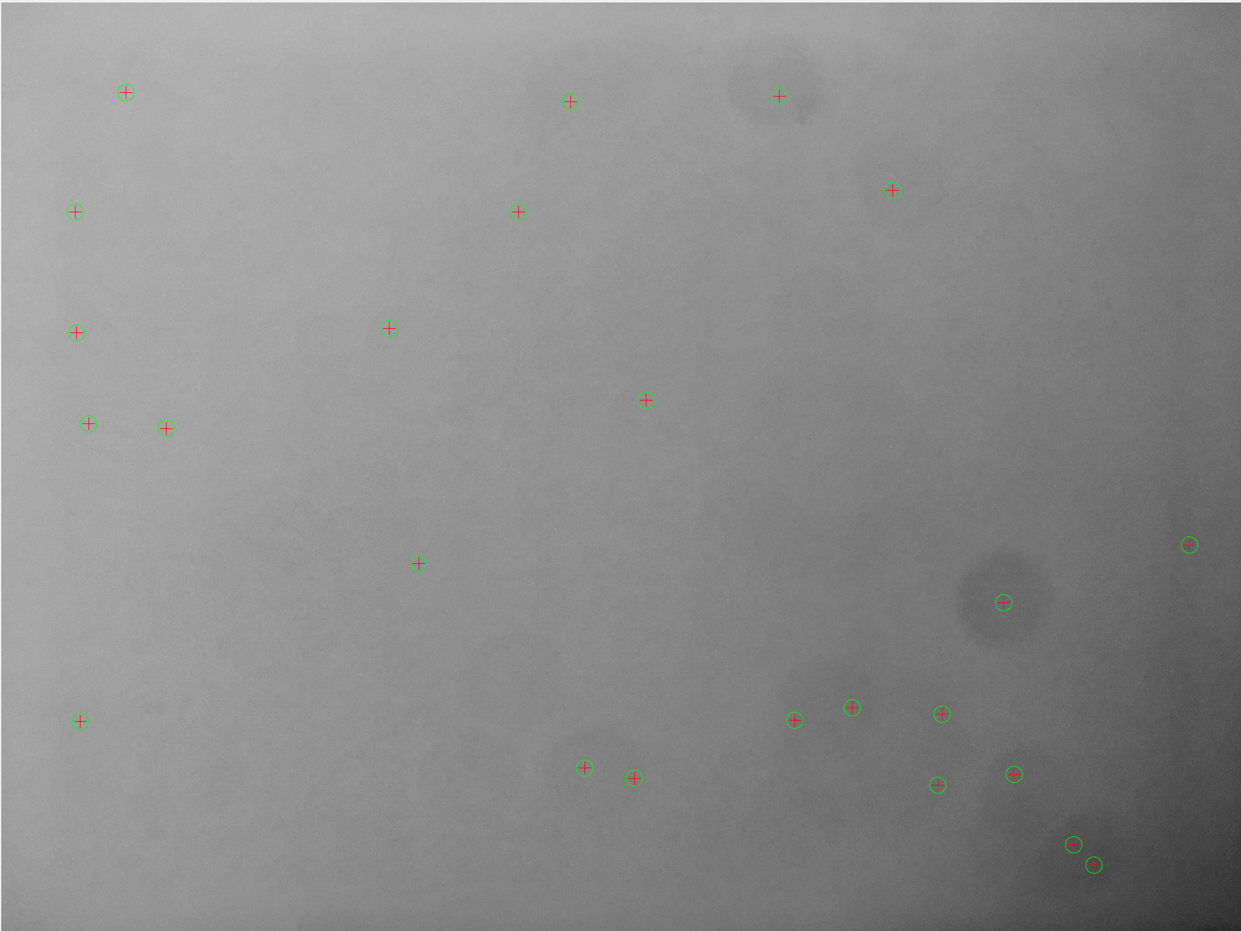
Modified_Rear_spot.jpg

Slide 15
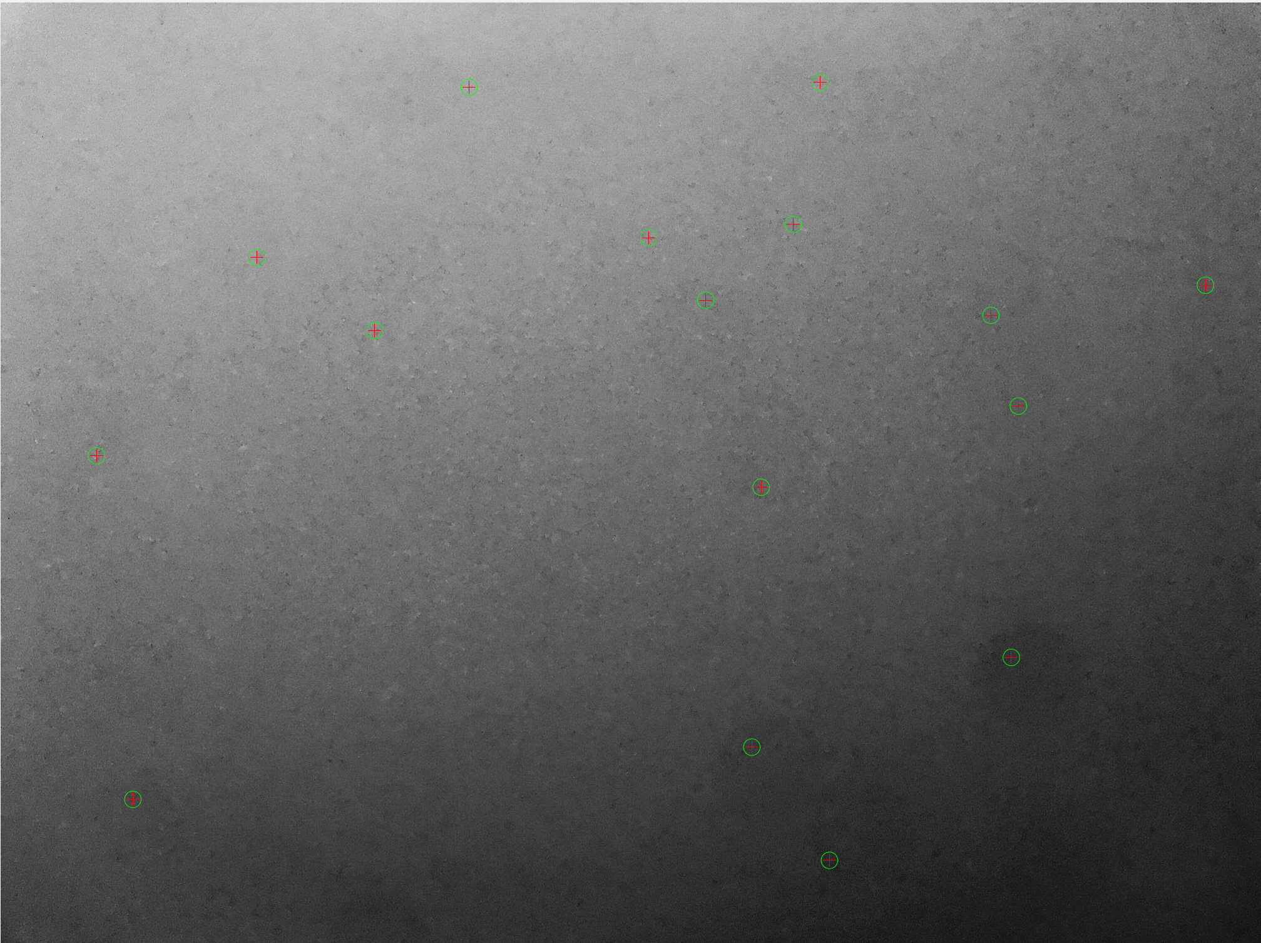
Modified_355319087540089_RearCameraBlackSpotPictureTest_1530117896291.jpg

Slide 16
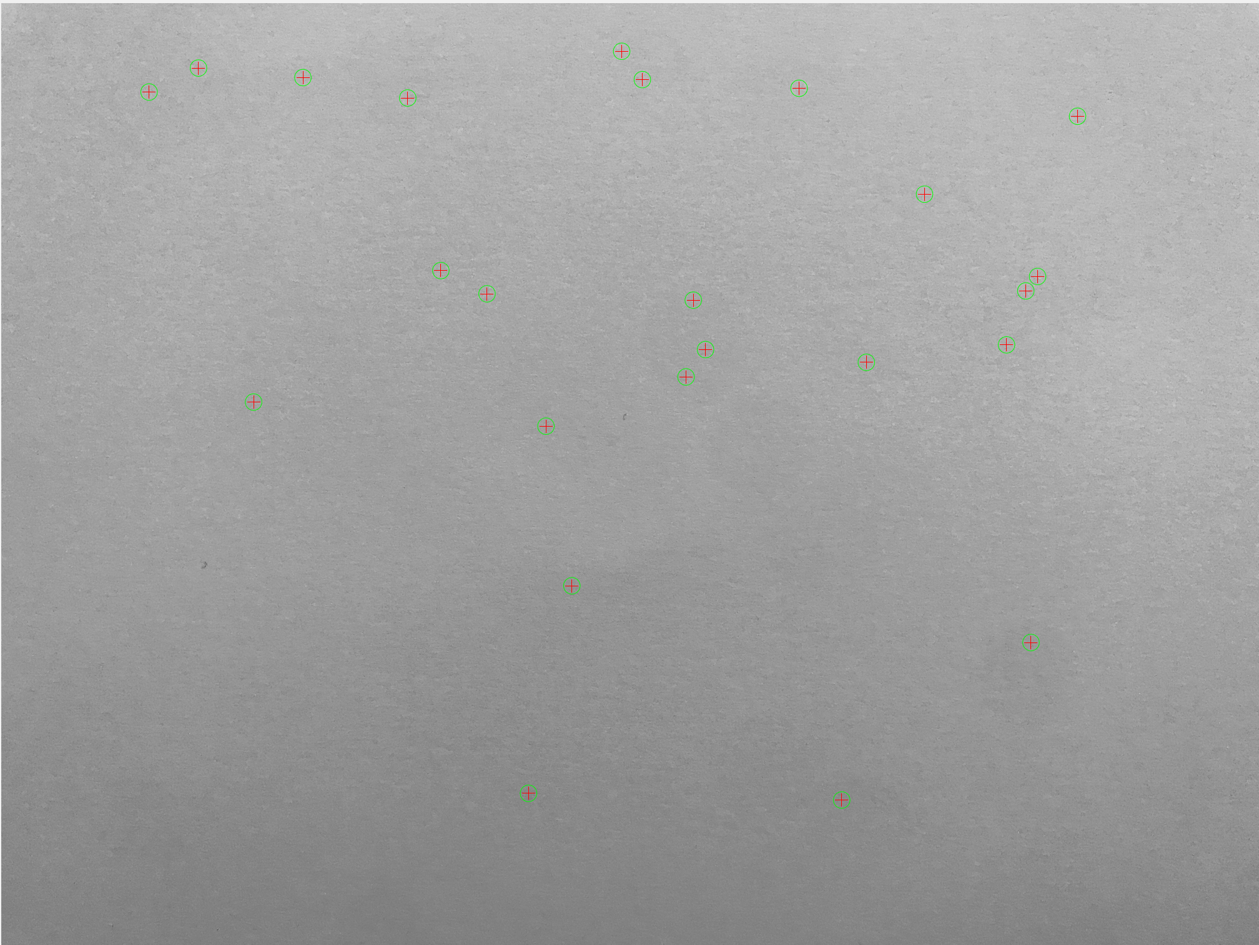
Rear.jpg

